Slide 1
CRaft: An Erasure-coding-supported Version of Raft for Reducing Storage Cost and Network Cost
Conference : FAST’2020
Author : Zizhong Wang, Tongliang Li, Haixia Wang, Airan Shao, Yunren Bai
Research unit : Shangming Cai, Zihan Xu, and Dongsheng Wang, Tsinghua University

Slide 2
BackGround
Consensus protocols, such as Paxos and Raft, can tolerate temporary failures in distributed services. They allow a collection of servers to work as a coherent group by keeping the commands in each server’s log in a consistent sequence. As long as most servers are not faulted, the cluster can work normally. Recently, Raft and Paxos have been applied in real large-scale systems like etcd, TiKV , to replicate terabytes of user data with better availability.
In such systems, data operations will be translated into log commands and then replicated into all servers by consensus protocols. Thus, data will be transferred to all servers, and then flushed to disks. In consensus problems, to tolerate any F failures, at least N = (2F +1) servers are needed.
Notes:
1.共识协议，如Paxos[12]和Raft[14]，可以容忍分布式服务中的临时故障。通过将每个服务器日志中的命令保持在一致的序列中，它们允许服务器集合作为一个连贯的组工作，它们允许服务器集合在大多数服务器都没有故障的情况下可以完全正常工作。最近，Raft和Paxos已应用于etcd[8]、TiKV[1]和FSS[11]等实际大型系统中，以更好的可用性复制TB级的用户数据。
2.在此类系统中，数据操作将转换为日志命令，然后通过一致协议复制到所有服务器。因此，数据将传输到所有服务器，然后刷新到磁盘。在一致性问题中，为了容忍任何F故障，至少需要N=（2F+1）个服务器。

Slide 3
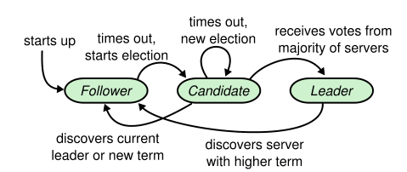
Raft
Raft Role
A Raft cluster contains several servers; five is a typical number, which allows the system to tolerate two failures.
At any given time each server is in one of three states: leader, follower, or candidate.In normal operation there is exactly one leader and all of the other servers are followers.
Followers are passive: they issue no requests on their own but simply respond to requests from leaders and candidates. The leader handles all client requests (if a client contacts a follower, the follower redirects it to the leader). The third state, candidate, is used to elect a new leader
Notes:
1. 1.一个 Raft 集群包含若干个服务器节点；通常是 5 个，这样的系统可以容忍 2 个节点宕机。
2.在任何给定的时间，每个服务器都处于三种状态之一:领导者、追随者或候选者。在正常操作中，只有一个leader，所有其他服务器都是follower。
3.Follower 都是被动的：他们不会发送任何请求，只是简单的响应来自 leader 和 candidate 的请求。Leader 处理所有的客户端请求（如果一个客户端和 follower 通信，follower 会将请求重定向给 leader）。第三种状态，candidate ，是用来选举一个新的 leader

Slide 4
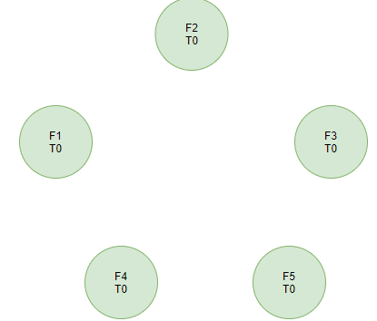
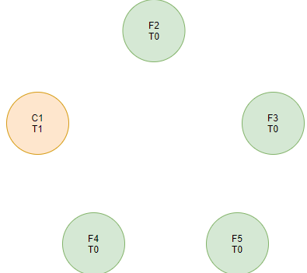
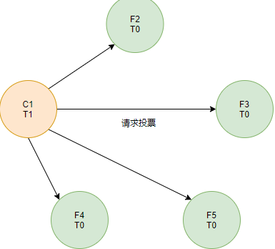
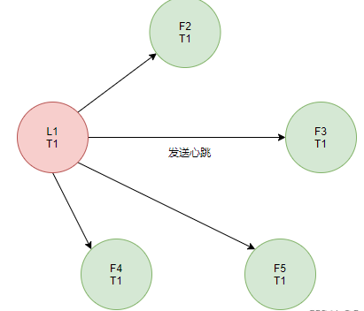
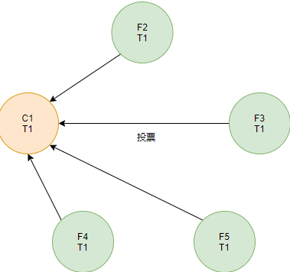
Raft Election

Slide 5
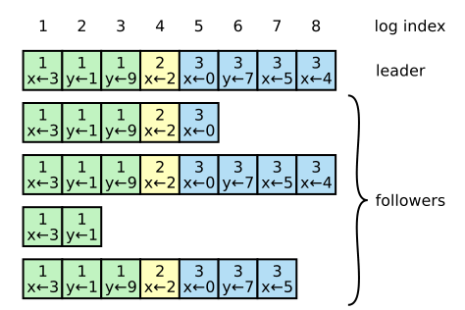
Raft Log
Log
Term: the term number when the entry was received by the leader
Index: an integer index identifying its position in the log.
Command: client request

Slide 6
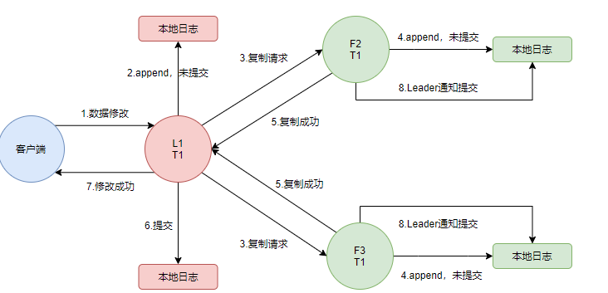
Raft Append

Slide 7
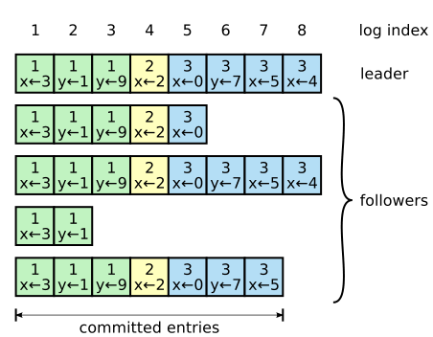
Raft Commited Entries
Commited Entries
A log entry is committed once the leader that created the entry has replicated it on a majority of the servers.This also commits all preceding entries in the leader’s log, including entries created by previous leaders.
Raft guarantees that committed entries are durable and will eventually be executed by all of the available state machines.
Notes:
1. 1.一旦创建该日志条目的 leader 将它复制到过半的服务器上，该日志条目就会被提交.
2.同时，leader 日志中该日志条目之前的所有日志条目也都会被提交，包括由其他 leader 创建的条目.
3.Raft 算法保证所有已提交的日志条目都是持久化的并且最终会被所有可用的状态机执行。

Slide 8
BackGround
Erasure coding is an effective technique to reduce storage and network costs compared to full-copy replication. It divides data into fragments, and encodes the original data fragments to generate parity fragments. The original data can be recovered from any large-enough subset of fragments, so erasure coding can tolerate faults. Reed-Solomon (RS) codes are the most commonly used.
Notes:
1.与全拷贝复制相比，擦除编码[16]是一种降低存储和网络成本的有效技术。它将数据划分为片段，并对原始数据片段进行编码以生成奇偶校验片段。原始数据可以从任何足够大的片段子集中恢复，因此擦除编码可以容忍错误。里德-所罗门（RS）码[16]是最常用的.

Slide 9
RS Code
There are two configurable positive integer parameters in RS codes, k and m.
Data are divided into k fragments with equal sizes. Then, using these k original data fragments, m parity fragments can be computed by an encoding procedure. So there will be (k + m) fragments generated from the original data.
The magic of a (k,m)-RS code is that any k out of total (k +m) fragments are enough to recover the original data, and that is how RS codes tolerate faults.
Notes:
RS码中有两个可配置的正整数参数，即k和m。
数据被分成大小相等的k个片段。然后，使用这k个原始数据片段，可以通过编码过程计算m个奇偶校验片段。因此，将从原始数据生成（k+m）片段。
（k，m）-RS码的神奇之处在于，总（k+m）片段中的任何k都足以恢复原始数据，这就是RS码容忍故障的方式。

Slide 10
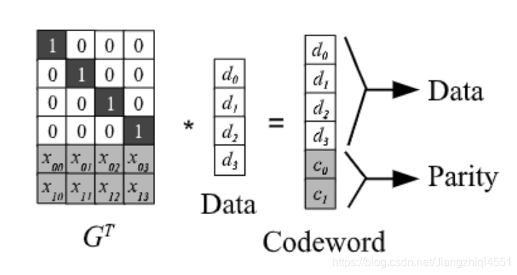
RS Code
K
K
M
Notes:
RS（k，m）通过将 k 个数据块的向量与生成矩阵（GT）相乘来实现，相乘得到一个码字（codeword）向量，码字向量由 k 个数据块和 m 个校验块构成
如果某个数据块丢失，可以用生成矩阵（GT）的逆矩阵乘以码字向量来还原出丢失的数据，RS(k，m)]最多可容忍 m 个块（包括数据块和校验块）丢失。

Slide 11
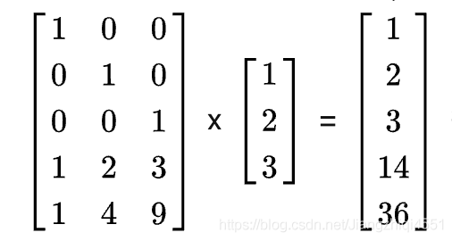
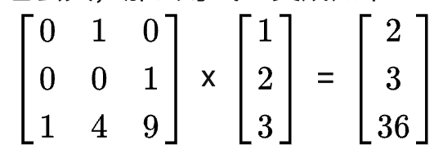
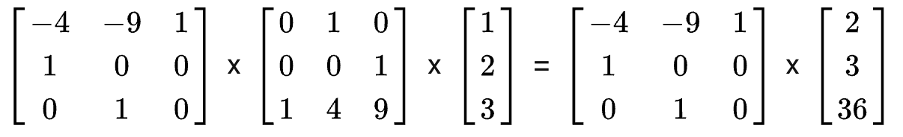
RS Code Example
Notes:
1. 假设现在有三个数据块组成一个向量，如下图所示：
2.在我们假设码字中丢失了两份数据 1 和 14 ，我们该怎么还原出原始数据？因为 1 和 14 丢失，所以我们可以去掉生成矩阵中的第一行和倒数第二行得到新的生成矩阵GT2，假设它们未参与计算，用现有的 2 3 36 构造等式如下
3.在此基础上，为了还原出原始数据 1 2 3 ，只需要在等式两边同时乘新生成矩阵GT2的逆矩阵，即可还原出数据。

Slide 12
Motivation
Using consensus protocols to tolerate failures may cause high network and storage costs which can be around N times of the original amount of data. Since these protocols are now applied in large-scale systems and the data volume is growing larger, these costs become real challenges and they can prevent systems from achieving low latency and high throughput.
If each server only needs to store a fragment (can be either an original data fragment or a parity one), not the complete copy of the data, storage and network costs can be greatly reduced.
Combining erasure coding and Paxos, RS-Paxos is a reform version of Paxos which can save storage and network costs. However, RS-Paxos decreases the fault tolerance number of failed servers. In other words, a RS-Paxos-applied system of N = (2F + 1) servers cannot tolerate F failures any longer. RS-Paxos’s liveness cannot be as good as Paxos or Raft.
Notes:
1.使用共识协议来容忍故障可能会导致较高的网络和存储成本，这可能是原始数据量的N倍左右。由于这些协议现在应用于大规模系统，并且数据量越来越大，因此这些成本成为真正的挑战，它们可能会阻止系统实现低延迟和高吞吐量。
2.如果每个服务器只需要存储一个片段（可以是原始数据片段或奇偶校验片段），而不是数据的完整副本，则可以大大降低存储和网络成本.
3. RS-Paxos结合了擦除编码和Paxos，是Paxos的一个改进版本，可以节省存储和网络成本。然而，RS-Paxos减少了故障服务器的容错数量,换句话说，由N=（2F+1）个服务器组成的RS-Paxos应用系统再也不能容忍F个故障。。如定理1所示，RS-Paxos的活性不能像Paxos或Raft那样好。

Slide 13
CRaft
Liveness is one of the most important properties of consensus protocols. However, the previous erasure-coding-supporting protocol, RS-Paxos, fails to reach an F liveness level. Thus, our goal is to design a new erasure-coding-supporting protocol (so it can save storage and network costs) that possesses an F liveness level.
This new protocol is based on Raft, so it inherits the basic concepts in Raft. To reduce network cost, leaders in the new protocol should be able to replicate their log entries to followers by using coded-fragments, like RS-Paxos.
Notes:
1.活性是共识协议最重要的属性之一。然而，先前的擦除编码支持协议RS-Paxos未能达到F活性水平。因此，我们的目标是设计一种新的具有F活性级别的擦除编码支持协议（这样可以节省存储和网络成本）。
2.该新协议基于Raft，因此继承了Raft中的基本概念。为了降低网络成本，新协议中的领导者应该能够使用编码片段（如RS-Paxos）将其日志条目复制到追随者

Slide 14
CRaft
Both coded-fragment replication and complete-entry replication are required in our new protocol. Using codedfragment replication can save storage and network costs, while complete-entry replication can keep liveness.
Theorem: When there are only (F + 1) healthy servers in an F liveness level protocol, an entry e can be committed only after the complete entry has been stored in all (F +1) healthy servers’ logs.
Proof: If a healthy server S did not store complete entry e when e was committed, the protocol could not guarantee that it could work fully functionally in any (F +1) healthy servers. Suppose only S and the previous unhealthy servers were healthy at the next moment, these (F + 1) currently healthy servers could not recover complete e, then the protocol had to wait for other servers. So when e was committed, all (F + 1) healthy servers had this complete entry.
Notes:
1.在我们的新协议中，编码片段复制和完整条目复制都是必需的。使用codedfragment复制可以节省存储和网络成本，而完整条目复制可以保持活力。
2.定理2.F活性级别协议中只有（F+1）个健康服务器时，只有在所有（F+1）个健康服务器的日志中存储了完整的条目后，才能提交条目e。
3.证据如果一个健康的服务器在提交e时没有存储完整的条目e，那么该协议不能保证它可以在任何（F+1）健康的服务器中完全工作。假设下一时刻只有S和以前不健康的服务器是健康的，这些（F+1）当前健康的服务器无法恢复完整的e，那么协议必须等待其他服务器。因此，当提交e时，所有（F+1）正常的服务器都有这个完整的条目。

Slide 15
CRaft
Some Parameters
Liveness Level: F
Number Of Servers: N=2F+1
(K,M)-RS: K+M=N
Notes:
1.

Slide 16
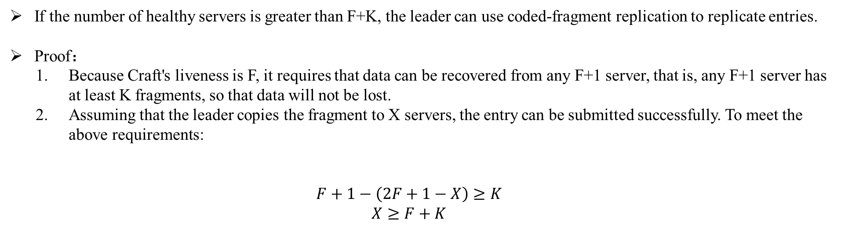
Coded-fragment Replication
If the number of healthy servers is greater than F+K, the leader can use coded-fragment replication to replicate entries.
Proof：
Because Craft's liveness is F, it requires that data can be recovered from any F+1 server, that is, any F+1 server has at least K fragments, so that data will not be lost.
Assuming that the leader copies the fragment to X servers, the entry can be submitted successfully. To meet the above requirements:
$$F+1−\left(2F+1−X\right)≥K$$
$$X≥F+K$$
Notes:
1.如果健康的服务器数量大于F+K，Leader可以使用编码片段复制来复制条目.
2.因为Craft的Liveness为F+1,这要求从任意F+1个Server都能恢复数据，也就是说任意F+1个Server至少有K个Fragment，这样数据才不会丢。
3.假设复制Fragment到X个Server上，Entry才能成功提交，为满足以上要求：
F+1-(2F+1-X)>=K
X>=F+K
也就是说至少要复制到F+K个Server上才能提交。

Slide 17
Coded-fragment Replication
When a leader in CRaft tries to replicate an entry by coded-fragment replication method, it first encodes the entry.
In Raft, each log entry should contain its original content from clients and also its term and index in the protocol. When a CRaft leader tries to encode an entry, the content can be encoded into N = (k + m) fragments by the (k,m)-RS code that the protocol chooses.
Term and index should not be encoded, since they play important roles in the protocol.
Notes:
1.当工艺领导者试图通过codedfragment复制方法复制条目时，它首先对条目进行编码。
2.在Raft中，每个日志条目都应该包含来自客户端的原始内容以及协议中的术语和索引。当工艺领导者尝试编码条目时，可以通过协议选择的（k，m）-RS代码将内容编码为N=（k+m）个片段。
3.术语和索引不应编码，因为它们在协议中起着重要作用。

Slide 18
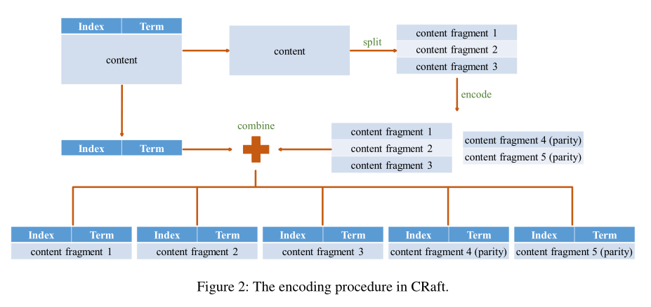
Coded-fragment Replication
Notes:
1.当工艺领导者试图通过codedfragment复制方法复制条目时，它首先对条目进行编码。在Raft中，每个日志条目都应该包含来自客户端的原始内容以及协议中的术语和索引。当工艺领导者尝试编码条目时，可以通过协议选择的（k，m）-RS代码将内容编码为N=（k+m）个片段。术语和索引不应编码，因为它们在协议中起着重要作用。

Slide 19
Coded-fragment Replication
After encoding, the leader will have N coded-fragments of the entry. Then it will send the corresponding coded-fragment to each follower. After receiving its corresponding codedfragment, each follower will reply to the leader.
When the leader confirms that at least (F + k) servers store a codedfragment, the entry and its previous ones can be safely applied. The leader will commit and apply these entries, and then inform followers to apply them.
The commitment condition of coded-fragment replication is stricter than Raft’s.
Notes:
编码后，前导将有N个条目的编码片段。然后将相应的编码片段发送给每个跟随者。在收到相应的codedfragment后，每个追随者都会回复领导者。
当领导者确认至少（F+k）个服务器存储了codedfragment时，可以安全地应用该条目及其以前的条目。领导者将提交并应用这些条目，然后通知追随者应用它们。
编码片段复制的承诺条件比Raft的更严格。

Slide 20
Coded-fragment Replication
When a leader is down, a new leader will be elected. If an entry is already committed, the election rule of Raft guarantees that the new leader at least has a fragment of the entry, which means the safety property can be guaranteed.
Since at least (F + k) servers store a fragment of a committed entry, there should be at least k coded-fragments in any (F + 1) servers.
So the new leader can collect k coded-fragments and then recover the complete entry when there are at least (F +1) healthy servers, which means liveness can be guaranteed.
Notes:
当一位领导人下台时，将选出一位新的领导人。如果一个条目已经提交，Raft的选举规则保证新领导人至少拥有该条目的一部分，这意味着可以保证安全性。
由于至少（F+k）个服务器存储一个已提交条目的片段，因此任何（F+1）个服务器中都应该至少有k个编码片段。
因此，当至少有（F+1）个健康的服务器时，新的领导者可以收集k个编码片段，然后恢复完整的条目，这意味着可以保证活跃性。

Slide 21
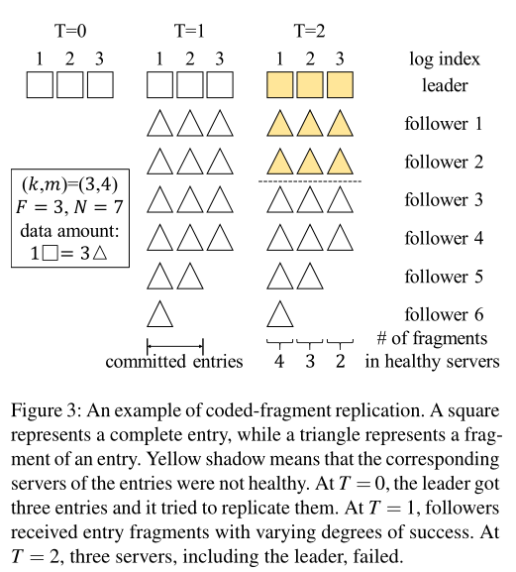
Coded-fragment Replication
Notes:
当一位领导人下台时，将选出一位新的领导人。如果一个条目已经提交，Raft的选举规则保证新领导人至少拥有该条目的一部分，这意味着可以保证安全性。
由于至少（F+k）个服务器存储一个已提交条目的片段，因此任何（F+1）个服务器中都应该至少有k个编码片段。
因此，当至少有（F+1）个健康的服务器时，新的领导者可以收集k个编码片段，然后恢复完整的条目，这意味着可以保证活跃性。

Slide 22
Complete-entry Replication
To reduce storage and network costs, leaders are encouraged to use coded-fragment replication. However, coded-fragment replication will not work when there are not (F + k) healthy servers.
When the number of healthy servers is greater than F and less than (F + k), the leader should use complete-entry replication method to replicate entries.
In complete-entry replication, the leader has to replicate the complete entry to at least (F + 1) servers before committing the entry, just like Raft. However, since CRaft supports coded-fragments, the leader can replicate an entry by coded-fragments rather than the complete entry to remaining followers after committing the entry.
Notes:
1.为了降低存储和网络成本，鼓励领导者使用编码片段复制。然而，当没有（F+k）健康的服务器时，编码片段复制将无法工作。
2.当正常服务器的数量大于F且小于（F+k）时，领导者应使用完整条目复制方法来复制条目。
3.在完整条目复制中，领导者必须在提交条目之前将完整条目复制到至少（F+1）个服务器，就像Raft一样。然而，由于CRaft支持编码片段，在提交条目后，领导者可以通过编码片段而不是将完整条目复制给其余的追随者。

Slide 23
Complete-entry Replication
In practical implementations, there are many strategies to replicate an entry via complete-entry replication. Define an integer parameter 0 ≤ p ≤ F. The leader can first send complete copies of an entry to (F + p) followers and then send coded-fragments to remaining (F − p) followers.
A smaller p means less storage and network costs, but it also means a higher probability to have longer committing latency (if no F out of (F + p) answers return in time, more rounds of communications may be required before commitment).
When p = F, the strategy becomes the same as Raft’s replication method. In our implementation for experiments, we choose p = 0..
Notes:
1.在实际实现中，有许多策略可以通过完整的条目复制来复制条目。定义整数参数0≤ p≤ F、 领导者可以首先将条目的完整副本发送给（F+p）追随者，然后将编码片段发送给剩余的（F）− p） 追随者。
2.较小的p意味着更少的存储和网络成本，但也意味着更高的概率具有更长的提交延迟（如果（F+p）回答中没有F及时返回，则在提交之前可能需要更多轮通信）。当p=F时，该策略与Raft的复制方法相同。

Slide 24
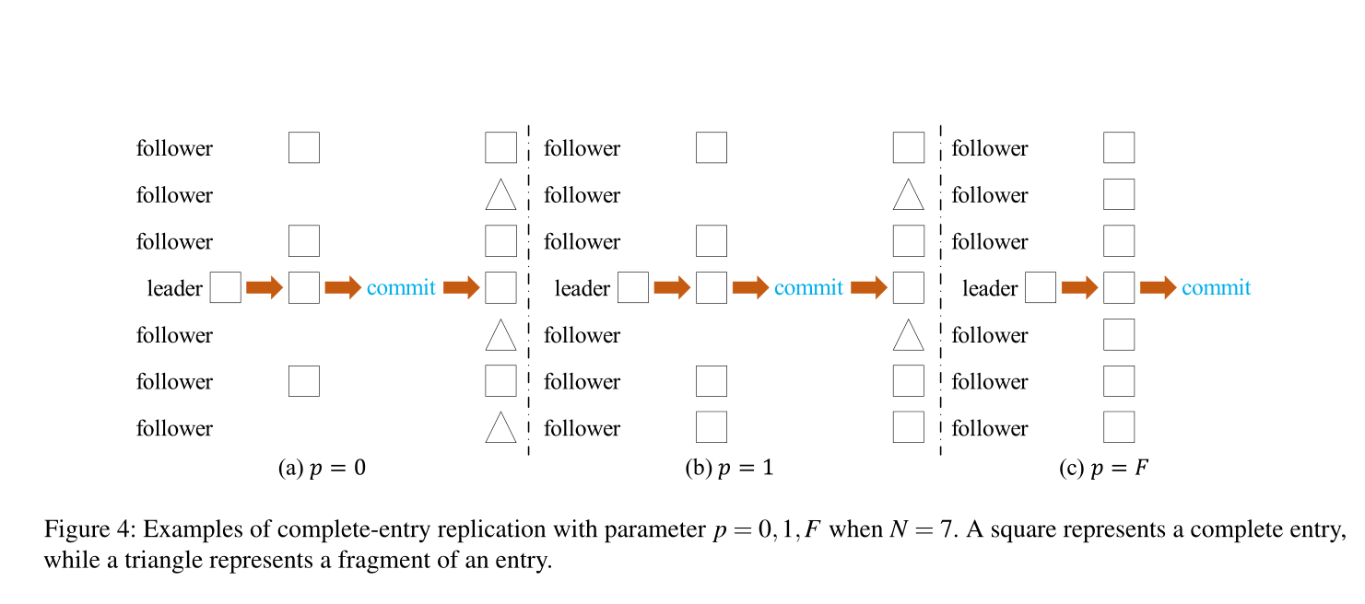
Complete-entry Replication
Notes:
1.在实际实现中，有许多策略可以通过完整的条目复制来复制条目。定义整数参数0≤ p≤ F、 领导者可以首先将条目的完整副本发送给（F+p）追随者，然后将编码片段发送给剩余的（F）− p） 追随者。
2.较小的p意味着更少的存储和网络成本，但也意味着更高的概率具有更长的提交延迟（如果（F+p）回答中没有F及时返回，则在提交之前可能需要更多轮通信）。当p=F时，该策略与Raft的复制方法相同。

Slide 25
Prediction
Using coded-fragment replication rather than complete-entry replication can achieve better performance, if both methods can replicate successfully. A greedy strategy is that the leader always tries to replicate entries by coded-fragment replication. If it finds out that there are not (F +k) healthy servers, it turns to replicate the entry by complete-entry replication.
Leader can only predict how many healthy servers it could communicate with when it tries to replicate an entry.
If the number of most recent heartbeat answers are not less than (F +k), the leader should use coded-fragment replication first, and then it tries complete-entry replication if coded-fragment replication does not work. Otherwise, the leader directly uses complete-entry replication.
Notes:
1.如果两种方法都能成功复制，则使用编码片段复制而不是完整条目复制可以实现更好的性能。贪婪策略是，领导者总是试图通过编码片段复制来复制条目。如果它发现没有（F+k）健康的服务器，它会转而通过完整的条目复制来复制条目。
2.领导者可以使用最新的心跳回答来估计健康服务器的数量。如果最近的心跳应答数不小于（F+k），则领导者应首先使用编码片段复制，然后在编码片段复制不起作用的情况下尝试完成条目复制。否则，领导者直接使用完整条目复制。

Slide 26
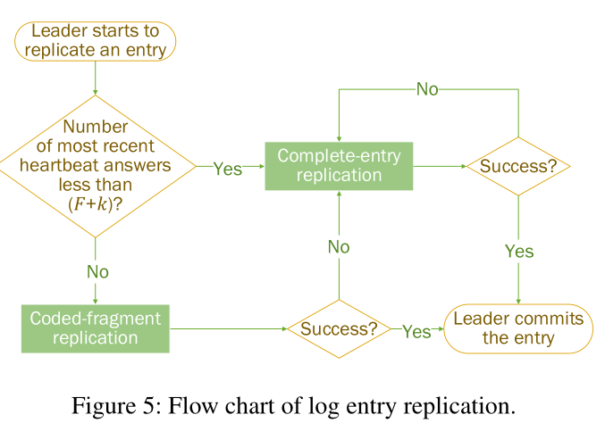
Prediction
Notes:
1.如果两种方法都能成功复制，则使用编码片段复制而不是完整条目复制可以实现更好的性能。贪婪策略是，领导者总是试图通过编码片段复制来复制条目。如果它发现没有（F+k）健康的服务器，它会转而通过完整的条目复制来复制条目。
2.领导者可以使用最新的心跳回答来估计健康服务器的数量。如果最近的心跳应答数不小于（F+k），则领导者应首先使用编码片段复制，然后在编码片段复制不起作用的情况下尝试完成条目复制。否则，领导者直接使用完整条目复制。

Slide 27
Newly-elected Leader
Both replication methods can guarantee safety and liveness when leaders have all complete entries.
However, when a leader is newly elected, it is likely that the newly-elected leader’s log does not have complete copies but only codedfragments of some entries. These incomplete entries are not guaranteed recoverable.
If some of these unrecoverable entries have not been applied by the newly-elected leader, the leader has no way to deal with these entries. The leader cannot send AppendEntries RPCs containing any one of these entries to the followers who need them, so these unrecoverable entries will retain unapplied. According to the rules of Raft, the leader’s new entries received from clients cannot be replicated to the followers as well.
To deal with unapplied coded-fragments, newly-elected leaders in CRaft should do the LeaderPre operation, before they can become fully-functioned leaders.
Notes:
1.当领导者拥有所有完整条目时，这两种复制方法都可以保证安全性和活性。
2.然而，当新当选的领导人时，新当选的领导人的日志可能没有完整的副本，而只有一些条目的代码片段。并且不能保证这些不完整的条目是可恢复的。
3.如果这些无法恢复的条目中有一些没有被新当选的领导人应用，那么领导人就没有办法处理这些条目。根据Raft的规则，领导者从客户那里收到的新条目也不能复制到追随者。
4.为了处理未应用的代码片段，新当选的工艺领导人应该在成为功能齐全的领导人之前进行领导预操作。

Slide 28
Newly-elected Leader
When a leader is newly-elected, it first checks its own log, finds out its unapplied coded-fragments. Then it asks followers for their own logs, focusing on the indexes of the unapplied coded-fragments. At least (F + 1) answers (including the new leader itself) should be collected or the new leader should keep waiting. The new leader should try to recover its unapplied coded-fragments in sequence.
For each entry, if there are at least k coded-fragments or one complete copy in (F + 1) answers, it can be recovered, but not allowed to be committed or applied immediately. Otherwise, the new leader should delete this entry and all the following ones (including complete entries) in its log.
After recovering or deleting all the unapplied entries, the whole LeaderPre operation can be done. During LeaderPre, the newly-elected leader should keep sending heartbeats to other servers, preventing them from timing out and starting new elections.
Notes:
当新当选的领导人时，它首先检查自己的日志，找出未应用的代码片段。然后，它要求追随者提供他们自己的日志，重点是未应用的编码片段的索引。至少应该收集（F+1）个答案（包括新领导本身），或者新领导应该继续等待。新的领导者应该尝试按顺序恢复其未应用的编码片段。
对于每个条目，如果（F+1）答案中至少有k个编码片段或一个完整副本，则可以恢复，但不允许立即提交或应用。否则，新领导应删除其日志中的此条目和以下所有条目（包括完整条目）。
在恢复或删除所有未应用的条目后，可以完成整个LeaderPre操作。在LeaderPre期间，新当选的领导人应不断向其他服务器发送心跳信号，防止它们超时并开始新的选举。

Slide 29
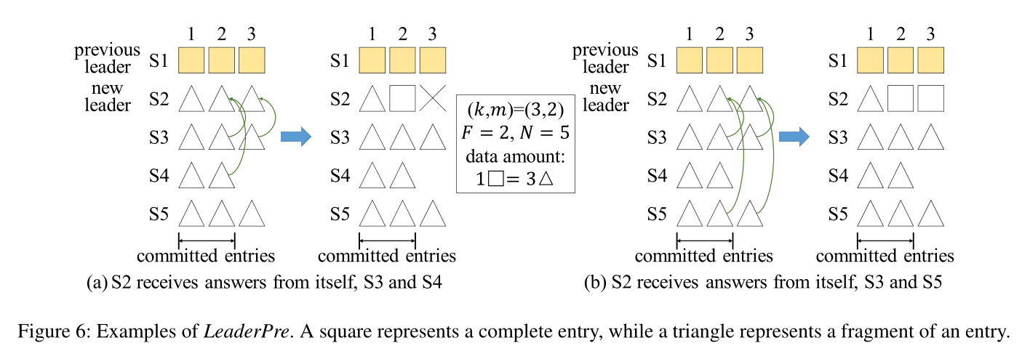
LeaderPre
Notes:
虽然如果S2从不同的服务器组收集答案，则未提交的索引3条目将得到不同的处理，但已提交的索引2条目将保证由LeaderPre恢复。

Slide 30
Newly-elected Leader
After adding LeaderPre, the Leader Append-Only Property in Raft has an exception: deletion in LeaderPre. In original Raft, the original Leader Append-Only Property is the key to prove safety, so it is necessary to prove that LeaderPre will not harm safety.
There are two major reasons that leaders in original Raft do not delete entries.
First, leaders have no way to find out whether an unapplied entry was committed by old leaders or not.
Second, even though an entry is unapplied, leaders can still replicate it to followers since it has the entry’s complete copy, so there is no need to delete it. In CRaft, if there are enough fragments of an unapplied entry, the new leader can recover it and be able to replicate it. Otherwise, the new leader can conclude that this entry is uncommitted.
Unrecoverable entries may harm CRaft’s liveness, but unrecoverable also means uncommitted, so it is reasonable to delete them.
Notes:
添加LeaderPre后，Raft中的Leader Append Only属性有一个例外：在LeaderPre中删除。在原筏中，原筏主仅附加属性是证明安全的关键，因此有必要证明筏主不会危害安全。
原始Raft中的领导者不删除条目有两个主要原因。首先，领导者无法确定未申请的条目是否是由老领导者犯下的。第二，即使一个条目未被应用，领导者仍然可以将其复制到关注者，因为它有该条目的完整副本，所以没有必要删除它。在CRaft中，如果有足够多未应用条目的碎片，新的领导者可以恢复并能够复制它。否则，新领导可以断定该条目未提交
不可恢复的条目可能会损害工艺品的活性，但不可恢复也意味着未提交，因此删除它们是合理的。

Slide 31
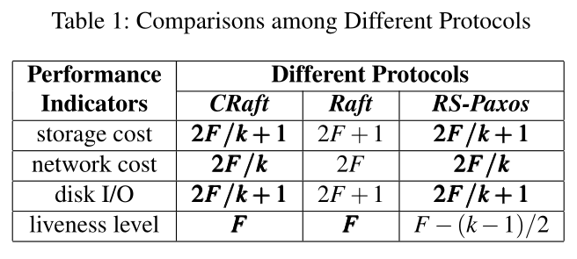
Perfromance
The advantages of CRaft are shown in Table 1. Using a (k,m)-RS code, CRaft has advantages in reducing storage and network costs. In CRaft, ideally, only coded-fragments are needed to be transferred between the leader and followers, which indicates that the network cost can be saved to 1/k. With this huge saving, CRaft can reach a much shorter latency and a higher throughput compared to original Raft.
The major difference between CRaft and RS-Paxos is liveness. To tolerate F failures, CRaft only needs to deploy (2F + 1) servers. However, RS-Paxos needs to deploy at least (2F + 3) servers. With the same parameter k in erasure coding, less servers required means that CRaft can save more storage and network costs compared to RS-Paxos.
Notes:
1CRaft的优势如表1所示。使用（k，m）-RS代码，CRaft在降低存储和网络成本方面具有优势。在CRaft中，理想情况下，只需要在领导者和追随者之间传输编码片段，这表明网络成本可以节省到1/K。通过这一巨大的节省，与原始Raft相比，CRaft可以达到更短的延迟和更高的吞吐量。
CRaft和RS Paxos之间的主要区别是活泼。为了容忍F故障，CRaft只需要部署（2F+1）服务器。然而，RS-Paxos需要部署至少（2F+3）个服务器。在擦除编码中使用相同的参数k，所需的服务器更少意味着与RS-Paxos相比，CRaft可以节省更多的存储和网络成本。

Slide 32
Perfromance
One of the major concerns is the extra consumption when a leader is newly-elected. The new leader has to collect entry fragments if there are some behind followers.
However, storage and network costs of CRaft in the worst situations are basically the same as Raft in any situations. Also, in most cases, the first new leader can replicate the old entries to all behind followers, so each entry only needs to be collected once extra. This harms the performance a little, but network cost is still greatly reduced generally, compared to Raft.
LeaderPre latency may affect election time, so it may affect the protocol’s availability. This kind of latency is possibly affected by the number of the new leader’s unapplied entries. However, a new leader can get brief information of its unapplied entries first and then collect them later. The time consumption of communicating brief information is quite short so that LeaderPre latency will not harm the protocol’s availability seriously.
Encoding time can be a problem too. However, many studies showed that encoding time is short enough compared to transfer time in practical systems. It is worth having a slightly longer encoding time to reduce network cost.
Notes:
其中一个主要问题是新当选的领导人会产生额外的消费。如果有一些追随者，新领导人必须收集条目碎片。
然而，在最坏的情况下，航天器的存储和网络成本基本上与任何情况下的Raft相同。此外，在大多数情况下，第一个新领导者可以将旧条目复制到所有后面的追随者，因此每个条目只需要额外收集一次。这对性能有点不利，但与Raft相比，网络成本总体上仍大大降低。
LeaderPre延迟可能会影响选举时间，因此可能会影响协议的可用性。这种延迟可能会受到新领导者未应用条目数量的影响。然而，新领导可以先获得未应用条目的简要信息，然后再收集。通信简短信息的时间消耗很短，因此LeaderPre延迟不会严重损害协议的可用性。
编码时间也可能是一个问题。然而，许多研究表明，与实际系统中的传输时间相比，编码时间足够短[6]。值得稍微延长编码时间以降低网络成本。

Slide 33
Evaluation
To evaluate our protocol, we first designed a key-value store based on Raft. Then we modified it to adapt CRaft. Since RSPaxos is based on Paxos but not Raft, it is difficult to compare RS-Paxos with CRaft or Raft directly. We took the insight of RS-Paxos and implemented an equivalent protocol named RS-Raft onto our key-value store. The parameters in RS-Raft have the same meanings as the ones in RS-Paxos. We ran experiments on the key-value store with different protocols to present an evaluation.
Notes:
为了评估我们的协议，我们首先设计了一个基于Raft的键值存储。然后我们修改它以适应工艺。由于RSPaxos基于Paxos而非Raft，因此很难直接将RS Paxos与CRaft或Raft进行比较。我们深入研究了RS-Paxos，并在我们的键值存储上实现了一个名为RS-Raft的等效协议。RS-Raft中的参数与RS-Paxos中的参数含义相同，如第2.3节所述。我们使用不同的协议在键值存储上进行了实验，以进行评估。

Slide 34
Evaluation
The key-value store we design supports three kinds of operations: Set, Append and Get. Set and Append operations must be logged, while Get operations are not.
The keys were accessed uniformly in our experimental workloads. Followers can just store fragments of their entries to reduce storage cost. However, the leader should keep complete copies of entries to ensure performance of Get.
After a new leader is elected, if there is a Get operation and the new leader only has a fragment of the data, it should first force at least (k − 1) followers’ log to catch up with its own, then collect enough data fragments from them and decode the data.
If the leader can directly respond to client’s Get, we call this operation a fast read. Otherwise, if the leader should collect fragments from followers first, we call this operation a recovery read. We used C++ to implement our key-value store. The structure of each server in our key-value store is shown in Figure 7. The consensus protocol can be Raft, CRaft and RS-Raft. We used RCF 3.0 to implement RPC, and we chose TCP as transmission protocol. Jerasure 2.0 is the library that we used for erasure coding.
Notes:
我们设计的键值存储支持三种操作：Set、Append和Get。必须记录Set和Append操作，而Get操作则不记录。在我们的实验工作负载中，密钥是统一访问的。追随者可以只存储其条目的片段，以降低存储成本。但是，领导应保留完整的条目副本，以确保Get的性能。在选出新的领导者后，如果存在Get操作，并且新领导者只有一段数据，则应首先强制至少（k− 1） 追随者的日志，以赶上自己的，然后收集足够的数据片段从他们和解码的数据。如果领导可以直接响应客户的Get，我们称此操作为快速读取。否则，如果领导者首先从追随者那里收集碎片，我们将此操作称为恢复读取。我们使用C++实现了键值存储。我们的键值存储中每个服务器的结构如图7所示。共识协议可以是Raft、CRaft和RS Raft。我们使用RCF 3.0[18]来实现RPC，并选择TCP作为传输协议。Jerasure 2.0[15]是我们用于擦除编码的库

Slide 35
Evaluation
We ran experiments on the configurations of N = 5 and N = 7, which are reasonable choices when using consensus protocols supporting erasure coding. K was set to 3, so the erasure code we used is a (3,2)-RS code (when N = 5) or a (3,4)-RS code (when N = 7). In N = 5 configuration, F = 2, so Raft and CRaft can tolerate any two failures. We chose QR = QW = 4 for RS-Raft, so it can tolerate one failure. In N = 7 configuration, F = 3, so Raft and CRaft can tolerate any three failures. We chose QR = QW = 5 for RS-Raft, so it can tolerate two failures.
Our experiments were run on Amazon EC2 platform. We used six (when N = 5) or eight (when N = 7) instances, one of them played the role of clients and the other instances were servers. Each instance has two virtual CPU cores and 8 GiB memory. The network bandwidth of each instance is about 550 Mbps. The storage devices we used are Amazon EBS General Purpose SSDs, each with 80000 IOPS and 1750 MB/s throughput.
Notes:
我们对N=5和N=7的配置进行了实验，当使用支持擦除编码的一致协议时，这两种配置是合理的选择。k设置为3，因此我们使用的擦除码是（3,2）-RS码（当N=5时）或（3,4）-RS码（当N=7时）。在N=5配置中，F=2，因此筏和艇可以承受任何两种故障。我们选择QR=QW=4作为RS Raft，因此它可以承受一次故障。在N=7的配置中，F=3，因此筏和船可以承受任何三种故障。对于RS-Raft，我们选择QR=QW=5，因此它可以承受两次故障。我们的实验在Amazon EC2平台上运行。我们使用了六个（当N=5）或八个（当N=7）实例，其中一个扮演客户机角色，其他实例是服务器。每个实例有两个虚拟CPU核和8 GiB内存。每个实例的网络带宽约为550 Mbps。我们使用的存储设备是Amazon EBS通用固态硬盘，每个具有80000 IOPS和1750 MB/s吞吐量。

Slide 36
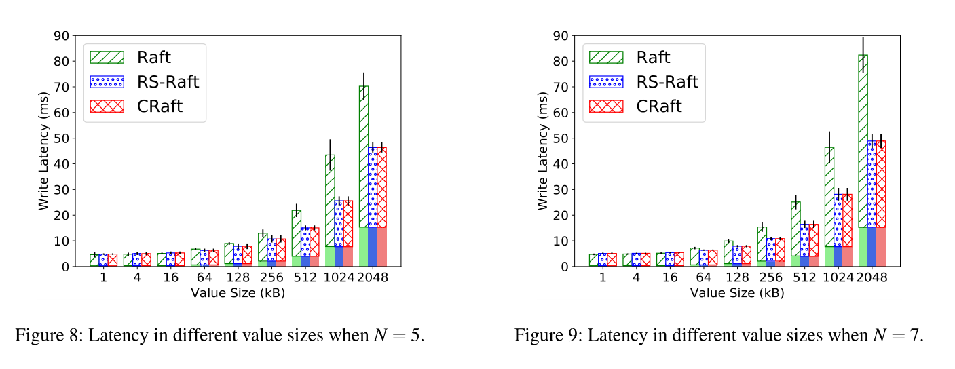
Latency
The part at the bottom with shadow is communication time from clients to the leader. This part of time is only influenced by value size. The other part is latency from the moment that the leader starts the entry to the moment that the leader commits it, and it is the part that we focus.
When value size is lower than 128 kB, three protocols perform evenly. In these situations, latency is mainly dominated by disk I/O.
When value size becomes larger, since CRaft and RS-Raft save network cost and disk I/O greatly, they reduce 20%–45% of latency compared to Raft when N = 5, and 20%–60.8% when N = 7.
Notes:
图8和图9中底部有阴影的部分是从客户端到领导者的通信时间。这部分时间只受价值大小的影响。另一部分是延迟，从领导者开始进入到领导者提交，这是我们关注的部分。

Slide 37
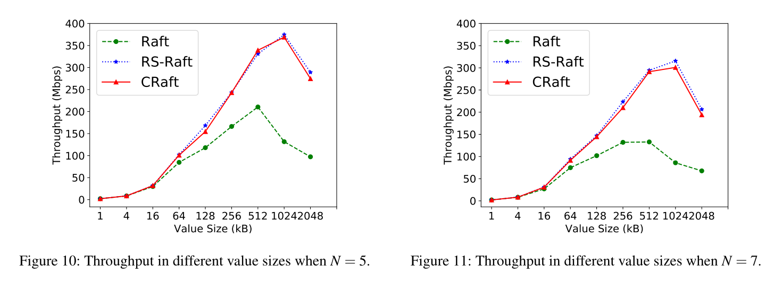
Throughput
RS-Raft can reach about 150%–200% improvements when value size is relatively large.
With value size grows larger, throughput first increases and reaches a peak, then it will fall. Throughput will fall because of network congestion.
CRaft and RS-Raft can have a 180% improvement on write throughput when N = 5 and 250% when N = 7. Also, the throughput peaks of CRaft and RS-Raft both appear much later than Raft’s. This is another advantage of CRaft and RS-Raft because of their reductions on network cost.
Notes:
随着价值规模的增大，吞吐量首先增加并达到峰值，然后下降。由于网络拥塞，吞吐量将下降。
当N=5时，CRaft和RS-Raft的写吞吐量可以提高180%，当N=7时，可以提高250%。此外，CRaft和RS-Raft的吞吐量峰值都比Raft的要晚得多。这是CRaft和RS-Raft的另一个优势，因为它们降低了网络成本。

Slide 38
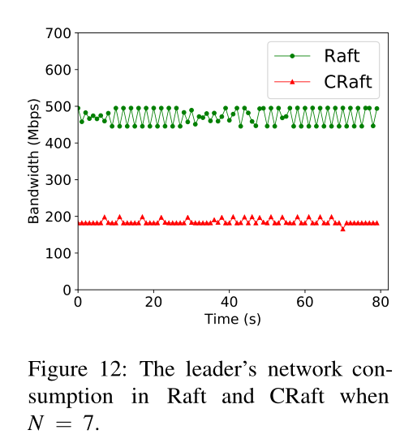
Network Cost
In this experiment, clients raised a write request every 70 ms.
The leader in Raft transfers about 250% of data amount compared to the leader in CRaft.

Slide 39
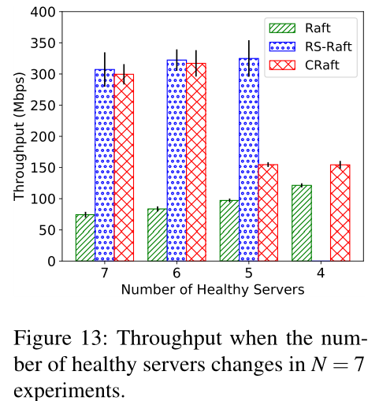
Liveness
RS-Raft performs very well when the number of healthy servers is no less than 5, but it cannot work when the number is 4.
CRaft performs just like RS-Raft when the number of healthy servers is 6 or 7, while it performs worse than RS-Raft when the number is 5. This is because CRaft can only use complete-entry replication when the number of healthy servers is 5, so its throughput is degraded.
However, CRaft can still work when the number of healthy servers is 4, just like Raft. And this proves CRaft’s liveness advantage to RS-Raft.
Notes:
当健康服务器的数量不少于5时，RS Raft的性能很好，但当数量为4时，它无法工作。当健康服务器数量为6或7时，CRaft的性能与RS Raft一样，而当数量为5时，它的性能比RS Raft差。这是因为当健康服务器数为5时CRaft只能使用完整条目复制，因此其吞吐量降低。然而，当健康服务器的数量为4时，CRaft仍然可以工作，就像Raft一样。这证明了该工艺对RS筏的活性优势。

Slide 40
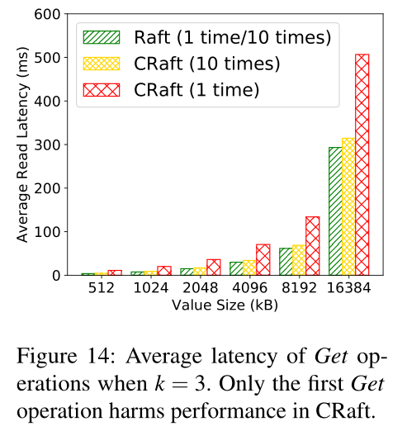
Recovery Read
We made a new leader handle a Get operation in different protocols, and then we repeated this Get operation nine more times and calculated average latency. The results are shown in Figure 14.
CRaft takes at most 140% more time compared to Raft handling the first Get operation.
However, time usages of ten operations between different protocols become close enough. So we can conclude that extra time usage of recovery read is acceptable
Notes:
与第一次操作相比，木筏操作最多需要140%的时间。然而，不同协议之间十个操作的时间使用变得足够接近。因此，我们可以得出结论，恢复读取的额外时间使用是可以接受的

Slide 41
Conclusion
We presented CRaft, an erasure-coded version of Raft. CRaft is based on Raft while it extents Raft to support erasure coding. With the help of erasure coding, storage and network costs can be greatly reduced.
The previous erasure-coding-supporting protocol, RSPaxos, fails to retain an F liveness level like Paxos or Raft. CRaft solves this problem. In other words, to tolerate F faults, CRaft only needs (2F + 1) servers while RS-Paxos needs more. So CRaft can save more storage and network costs.
We analyzed the performance of different protocols and we concluded that CRaft can reduce storage and network costs most while it has the best liveness. We designed a keyvalue store and ran experiments on it. The results show that CRaft can reduce 60.8% of latency and improve throughput by 250% compared to Raft. In the future, we will attempt to implement CRaft onto practical systems.
Notes:
我们介绍了CRaft，一种Raft的擦除编码版本。CRaft是基于Raft的，而它扩展了Raft以支持擦除编码。借助擦除编码，可以大大降低存储和网络成本。以前的擦除编码支持协议RSPaxos无法像Paxos或Raft那样保持F活性水平。CRaft解决了这个问题。换句话说，为了容忍F故障，CRaft只需要（2F+1）个服务器，而RS Paxos需要更多。因此，CRaft可以节省更多的存储和网络成本。我们分析了不同协议的性能，得出结论，CRaft在具有最佳活性的同时，可以最大程度地降低存储和网络成本。我们设计了一个键值存储，并对其进行了实验。结果表明，与Raft相比，CRaft可以减少60.8%的延迟，提高250%的吞吐量。未来，我们将尝试在实际系统上实现工艺。

Slide 42
Problem
集群配置更改?增删节点。会不会影响安全性？更改生成矩阵好像不会影响数据存储，但是新当选的LeaderCommit的日志数据是Fragment，怎么发？
如果一个正常很久的Leader宕机，新的Leadrer上没有完整数据的日志就很多，读性能就会降低。
新当选的Leader怎么读数据？？怎么知道Key在那条日志里？
Follower有必要应用到数据库里吗？KV都已经分片了。
Raft是顺序提交的，如果前一个Coded Fragment因为宕机没有提交，后面的就需要等待?
给Follower发快照就会很复杂，Follower落后很多只能一条一条赶上Leader。
Notes:
我们介绍了CRaft，一种Raft的擦除编码版本。CRaft是基于Raft的，而它扩展了Raft以支持擦除编码。借助擦除编码，可以大大降低存储和网络成本。以前的擦除编码支持协议RSPaxos无法像Paxos或Raft那样保持F活性水平。CRaft解决了这个问题。换句话说，为了容忍F故障，CRaft只需要（2F+1）个服务器，而RS Paxos需要更多。因此，CRaft可以节省更多的存储和网络成本。我们分析了不同协议的性能，得出结论，CRaft在具有最佳活性的同时，可以最大程度地降低存储和网络成本。我们设计了一个键值存储，并对其进行了实验。结果表明，与Raft相比，CRaft可以减少60.8%的延迟，提高250%的吞吐量。未来，我们将尝试在实际系统上实现工艺。

